Slide 1

Local Library Website.
GUIDED BY:
DR.ARUL RAJ
DR.MOORTHY
BY
SHRUTHI SREE R (192421129)
NITHIYA SHREE M (192421101)
BATCH 11

Slide 2



AIM & OBJECTIVE
Aim:
To design and implement a web-based Local Library System.
Objectives:
Provide easy book catalog search.
Allow users to borrow/return books online.
Track due dates and calculate fines automatically.
Offer an admin dashboard for library staff

Slide 3

ABSTRACT
Cloud providers host multiple tenants on shared infrastructure.
Efficient scheduling is needed for balancing workloads.
Proposed model improves resource utilization, reduces energy consumption, and ensures tenant isolation.
Outcome: Better performance and optimized VM placement strategy

Slide 4
LITERATURE REVIEW
Author(s) | Published Year | Title | Key Findings
Kamal Acharya | 2019 | Library Management System | Developed a computerized system featuring user and admin logins, online notice boards, and automated book tracking.
Jiahao Liang | 2023 | Library Management Database Design and Application | Proposed a MySQL-based database design emphasizing efficient data management for modern libraries.
Tsega Weldu Araya & Adhana Mengsteab | 2019 | Designing Web-based Library Management System | Focused on creating a web-based system to streamline library operations and enhance user experience.

Slide 5

PROBLEM STATEMENT
Current scheduling strategies fail to balance multi-tenant workloads efficiently
High VM migration overhead reduces performance
CPU, memory, and storage resources often underutilized
Tenants experience unfair allocation of resources

Slide 6

EXISTING SYSTEM
Static scheduling policies (Round Robin, FCFS)
Limited scalability for large tenant workloads
High migration and energy overhead
No adaptive mechanism for resource fluctuations

Slide 7

PROPOSED SYSTEM
Reduces unnecessary migrations
Places VMs based on resource demand and availability
Places VMs based on resource demand and availability
Adaptive scheduling policy using load balancing

Slide 8
REQUIREMENT ANALYSIS
Software Requirements
OS: Windows 10/11
Editor: VS Code / Sublime Text
Programming: HTML, CSS, JavaScript
Server: Node.js (Express)
Browser: Chrome / Edge
Hardware Requirements
Processor: Intel i3/i5 or higher
RAM: 4 GB or more
Storage: 100 GB minimum

Slide 9
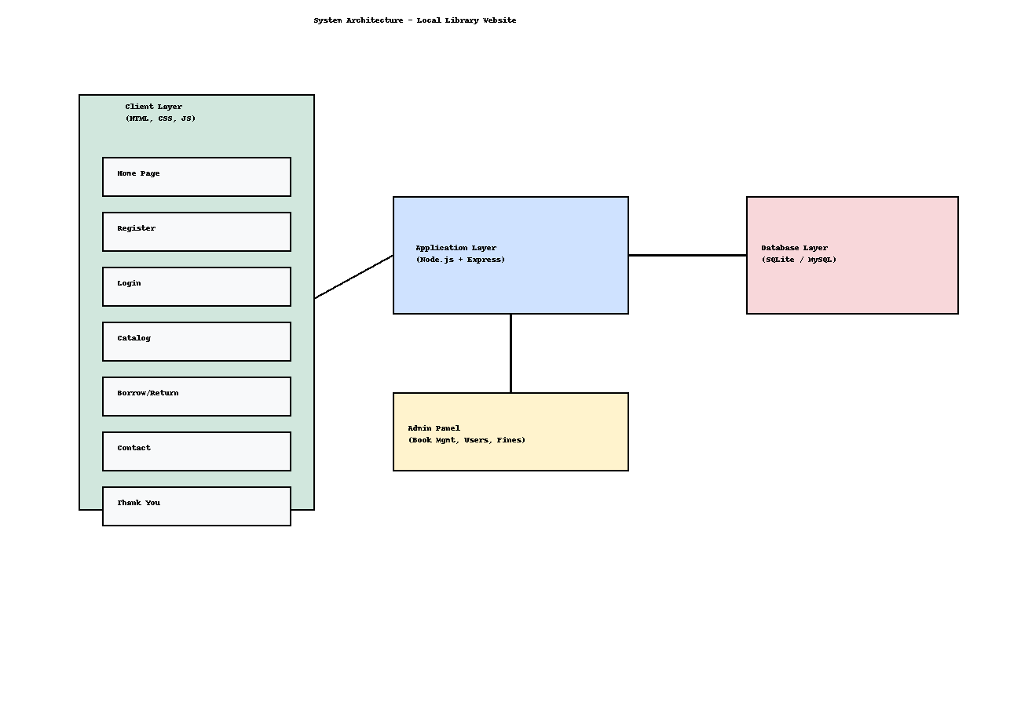
ARCHITECTURE

Slide 10
MODULE 1: USER INTERFACE & CATALOG MANAGEMENT

Slide 11
DEVELOPMENT
Development
The development of Module 1 focused on creating a user-friendly interface that allows users to search, view, and borrow books.
Front-end: Designed using HTML, CSS, and JavaScript to ensure responsive and attractive pages.
Search and filter options for books.
User login and registration pages.
Borrow and return request forms.
Contact form for user queries.
Dashboard for users to view borrowed books.

Slide 12
METHODOLOGY
The Incremental Development Model was used for this module.
The website was built and tested in small, manageable parts — starting with the interface, then linking it to the database, and finally adding user interactions.
Each function (search, login, borrow, etc.) was completed and reviewed before moving to the next.
User feedback from early versions helped improve usability and responsiveness.

Slide 13
SYSTEM DESIGN
Admin Dashboard Layout:
Side navigation for Books, Users, Transactions, and Reports.
Main panel displaying real-time statistics (borrowed books, overdue fines).
Database Design:
Tables: Admin, Books, Borrow_Records, Fine_Calculations.
Relationships:
Each transaction linked to a book and a user.
Fines automatically generated from Borrow_Records table based on due date.

Slide 14
TESTING AND REVIEW
Testing Techniques:
Functional Testing: Verified add/edit/delete operations for books and users.
Security Testing: Checked admin login authentication and access restrictions.
System Testing: Confirmed proper fine calculation and data updates.
Review:
Admin dashboard reviewed by faculty and peers for functionality and ease of use.
Minor UI adjustments made based on feedback.

Slide 15
MODULE 2: ADMIN DASHBOARD & INVENTORY CONTROL

Slide 16
DEVELOPMENT
The development of Module 2 involved building a secure and efficient system for administrators to manage library operations.
Admin Login: Implemented authentication to restrict access to authorized users only.
Inventory Management: Created CRUD (Create, Read, Update, Delete) features for books and user data.
Fine Calculation: Automated fine generation based on overdue days from the borrowing records.
Activity Monitoring: Added a report section for tracking all transactions and returned books.
Technologies Used: HTML, CSS, PHP/Node.js, and MySQL for database connectivity.

Slide 17
METHODOLOGY
The Spiral Model was adopted for this module, as it allowed iterative development with risk analysis and testing at every stage.
The process began with planning and identifying admin requirements.
Then prototypes were developed for core features like book management and fine tracking.
Each prototype underwent testing and improvement before integration.
This ensured that data accuracy, security, and functionality were maintained throughout the development cycle.

Slide 18
SYSTEM DESIGN
Admin Dashboard Layout:
Side navigation for Books, Users, Transactions, and Reports.
Main panel displaying real-time statistics (borrowed books, overdue fines).
Database Design:
Tables: Admin, Books, Borrow_Records, Fine_Calculations.
Relationships:
Each transaction linked to a book and a user.
Fines automatically generated from Borrow_Records table based on due date.

Slide 19
TESTING AND REVIEW
Testing Techniques:
Functional Testing: Verified add/edit/delete operations for books and users.
Security Testing: Checked admin login authentication and access restrictions.
System Testing: Confirmed proper fine calculation and data updates.
Review:
Admin dashboard reviewed by faculty and peers for functionality and ease of use.
Minor UI adjustments made based on feedback.

Slide 20
Implementation
The Local Library Website was developed using HTML, CSS, and JavaScript.
The pages include Home, Register, Login, Catalog, Borrow/Return, Contact, and Thank You.
Each page is linked together for smooth navigation.
Basic interactivity is handled using JavaScript (form validation, alerts, etc.).
Designed and tested using Visual Studio Code and run locally in a web browser (Chrome/Edge).
Provides a responsive and user-friendly interface for managing library operations.

Slide 21
Implementation
Login Page
ADMIN DASHBOARD
Allows existing users to log in
Secure authentication using sessions
Redirects to user dashboard after login
Admin can add/remove books
View borrowed/returned book logs
Monitor users and calculate fines

Slide 22
Implementation
Catalog Page
Borrow/Return Page
Displays book list with availability status
Users can search and view details
Connected dynamically to the database
Lets users borrow and return books
Updates book availability instantly
Tracks due dates and calculates fines

Slide 23
Implementation
Contact Page
Enables users to reach out to admin/staff
Simple contact form using HTML and Node.js
Sends user messages to admin inbox

Slide 24
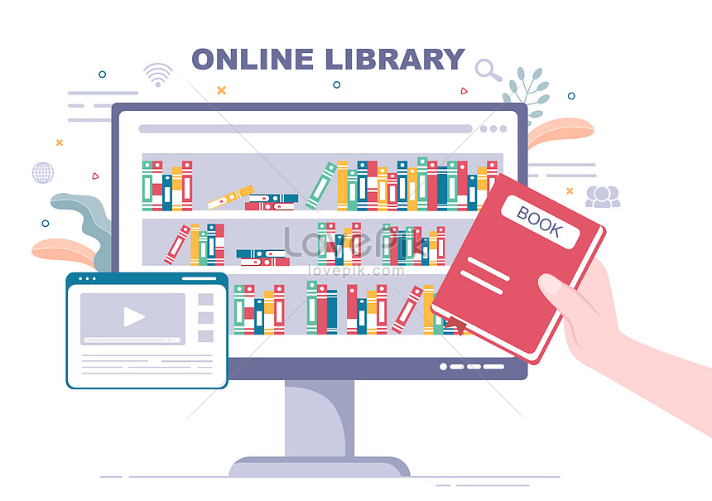
Results
Smooth user experience for book operations
Easy management through admin dashboard
Reduced manual errors in tracking and fine calculation

Slide 25
FUTURE ENHANCEMENT
Add a mobile app version for easy book search and borrowing.
Include online fine payment through UPI or card.
Send email or SMS alerts for due dates and new books.
Use AI suggestions to recommend books to users.
Provide e-book access for online reading.
Allow multiple admins with different access levels.
Add data charts to track most borrowed books.
Store data on cloud servers for backup and reliability.

Slide 26
Conclusion
The project successfully digitizes library operations.
Achieves improved accessibility and resource management.
Future enhancement: integration of online payment and AI-based recommendations.

Slide 27
REFERENCES
Welling, L., & Thomson, L. (2017). PHP and MySQL Web Development (5th ed.). Addison-Wesley Professional. → Used for understanding PHP–MySQL integration in web applications.
Duckett, J. (2011). HTML & CSS: Design and Build Websites. John Wiley & Sons. → Referred for front-end design principles and responsive layout creation.
Robbins, J. N. (2018). Learning Web Design: A Beginner’s Guide to HTML, CSS, JavaScript, and Web Graphics (5th ed.). O’Reilly Media. → Used to learn about user interface design and web usability concepts.
Silberschatz, A., Korth, H. F., & Sudarshan, S. (2020). Database System Concepts (7th ed.). McGraw-Hill Education. → Referenced for designing and managing the project’s database structure.
W3Schools. (2024). Web Development Tutorials. Retrieved from https://www.w3schools.com → Used for syntax help and examples during front-end and back-end development.

Slide 28
thank you

